Slide 1
RHD2000 Features
Fully Integrated Electrophysiology front end chip
16-bit ADC
30 kSamples/s/channel
32 or 16 channel input
16 channel differential input
SPI interface with microcontroller
Low input-referred noise: 2.4 uV
DSP to filter out DC noise
Adjustable lower and upper cutoff frequency
Each amplifier on/off controable
Each amplifier consumes: 7.6uA/kHz
Based on upper cutoff frequency

Slide 2
RHD2000 Characteristic
Electrical Characteristic
VDD = 3.3v
Baseline Amplifer current = 200 uA
Amplifier current = 7.6uA/kHz
Baseline ADC current = 510uA
ADC current = 2.14uA/(kS/s)
SPI current = 40 uA
Mechanical Characteristic
L x W x H = 8 x 8 x 0.85 (mm)

Slide 3
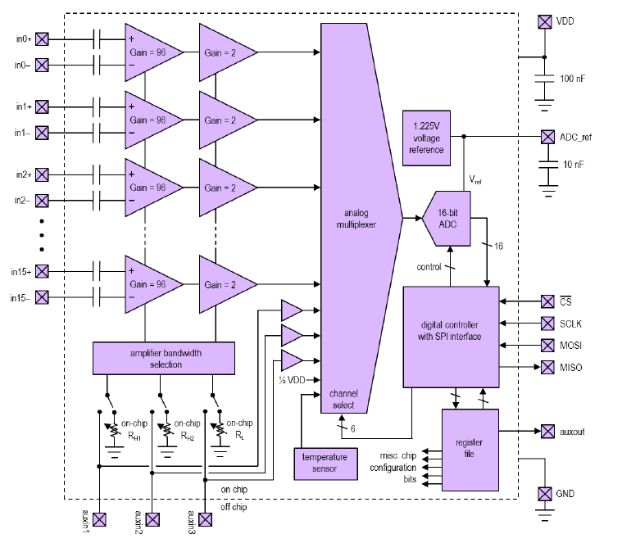
RHD2216 Block Diagram

Slide 4
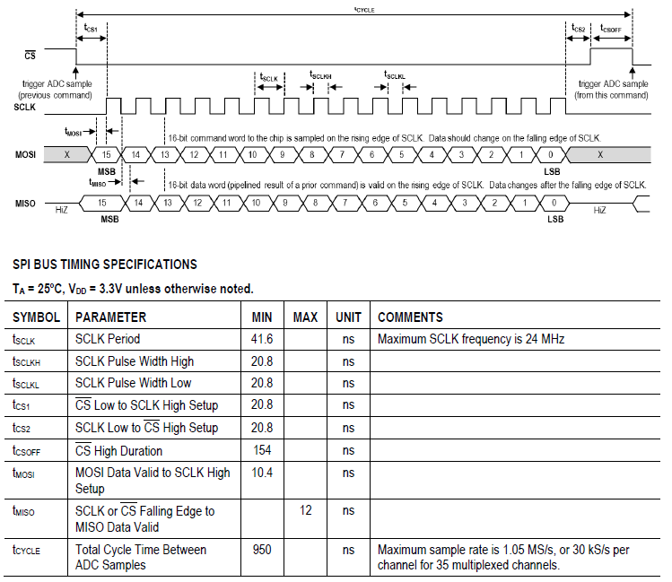
RHD2000 Timing Diagram

Slide 5
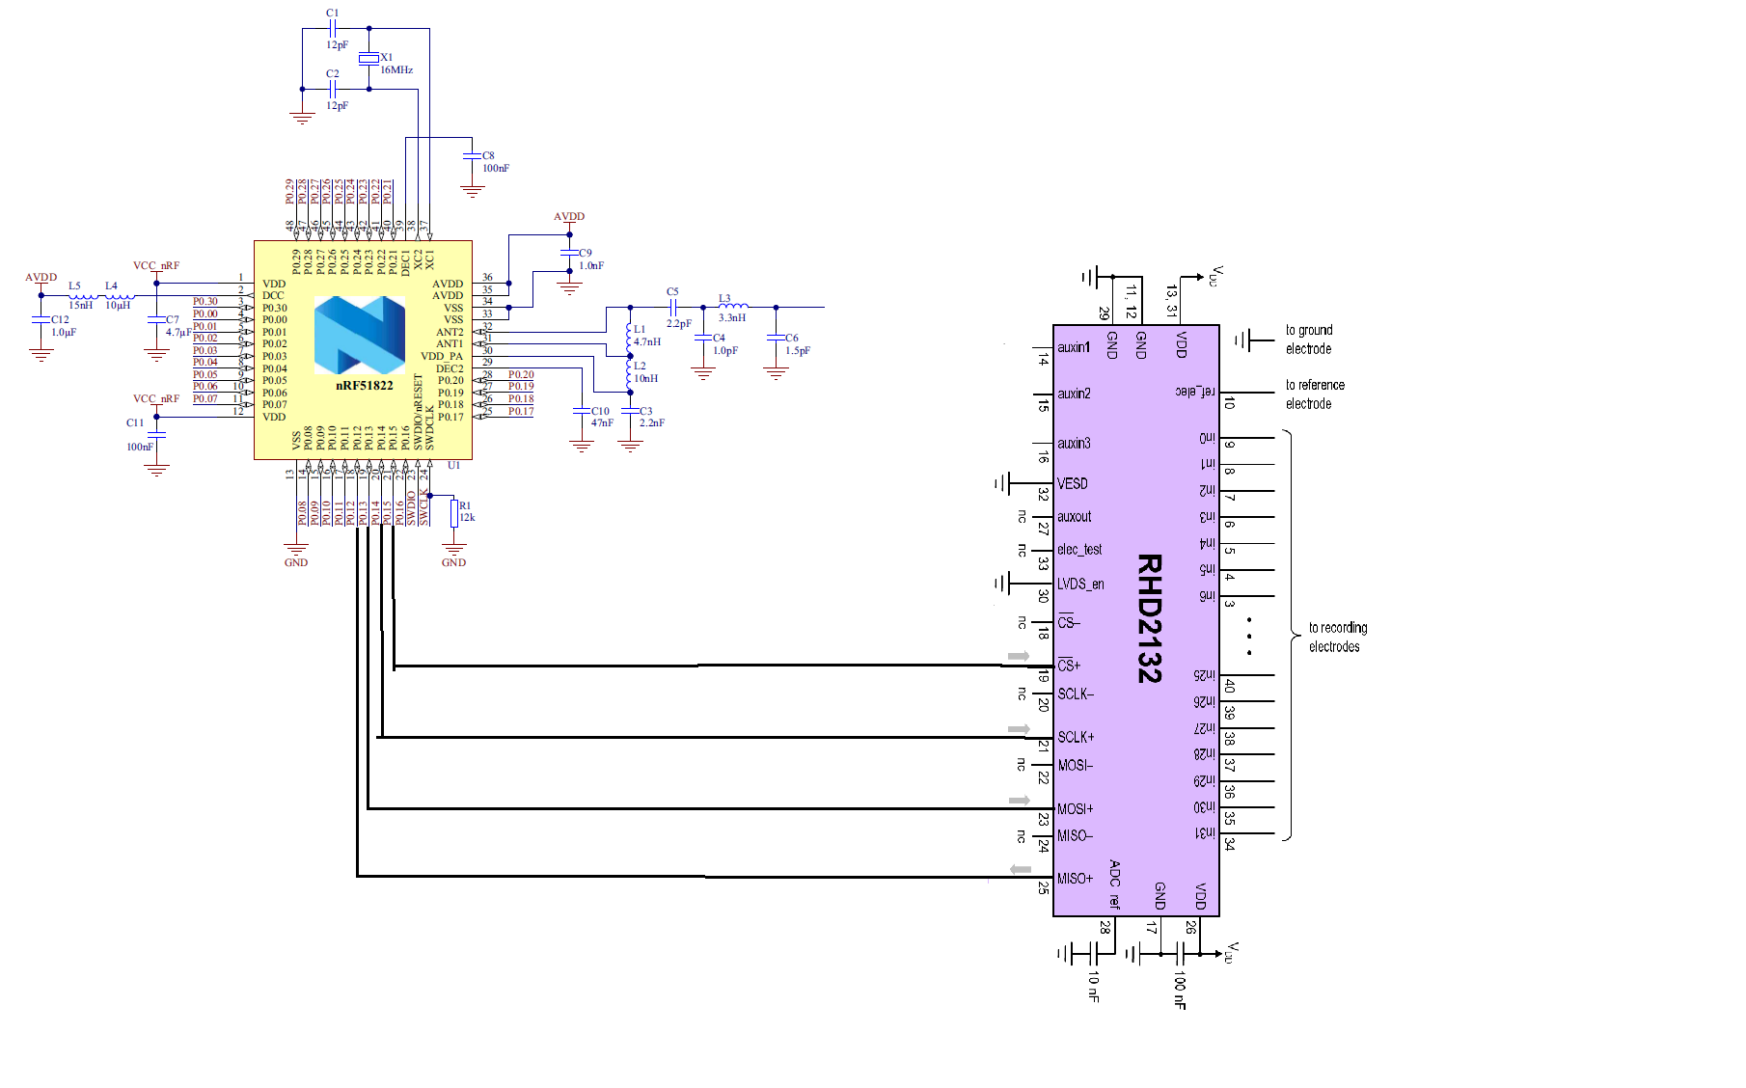
RHD2000 Interface with nRF51822

